Slide 1
What are the Challenges for TinyML?
Part A

Slide 2


Embedded
Systems
TinyML
Machine
Learning

Slide 3

Embedded
Systems
Embedded
Systems
TinyML
Machine
Learning

Slide 4

Building Blocks of Computing Hardware

Slide 5
Hardware
Software

Slide 6
Hardware
Software

Slide 7
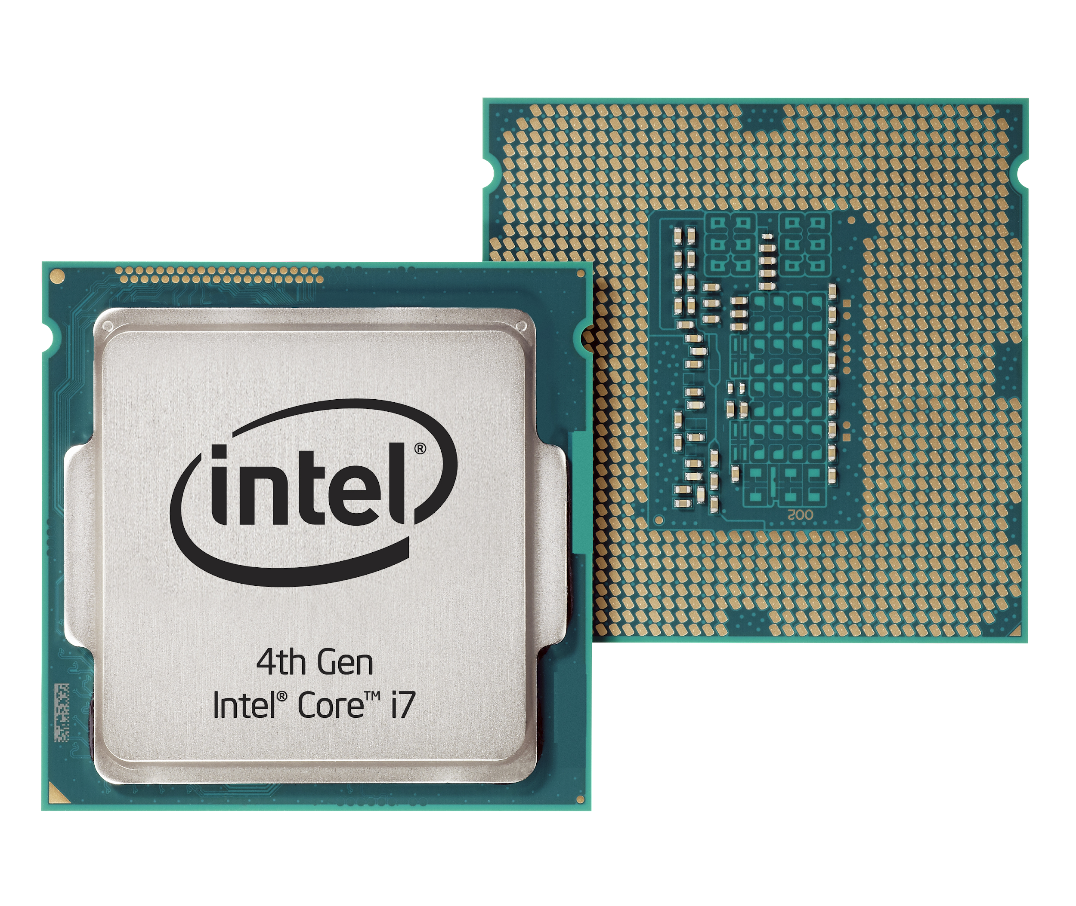
Compute
Memory
Storage
Notes:
https://www.flickr.com/photos/intel_de/9662277285/
https://commons.wikimedia.org/wiki/File:Swissbit_2GB_PC2-5300U-555.jpg
https://commons.wikimedia.org/wiki/File:Samsung_840_EVO_SSD-6_-_top_black.jpg

Slide 8
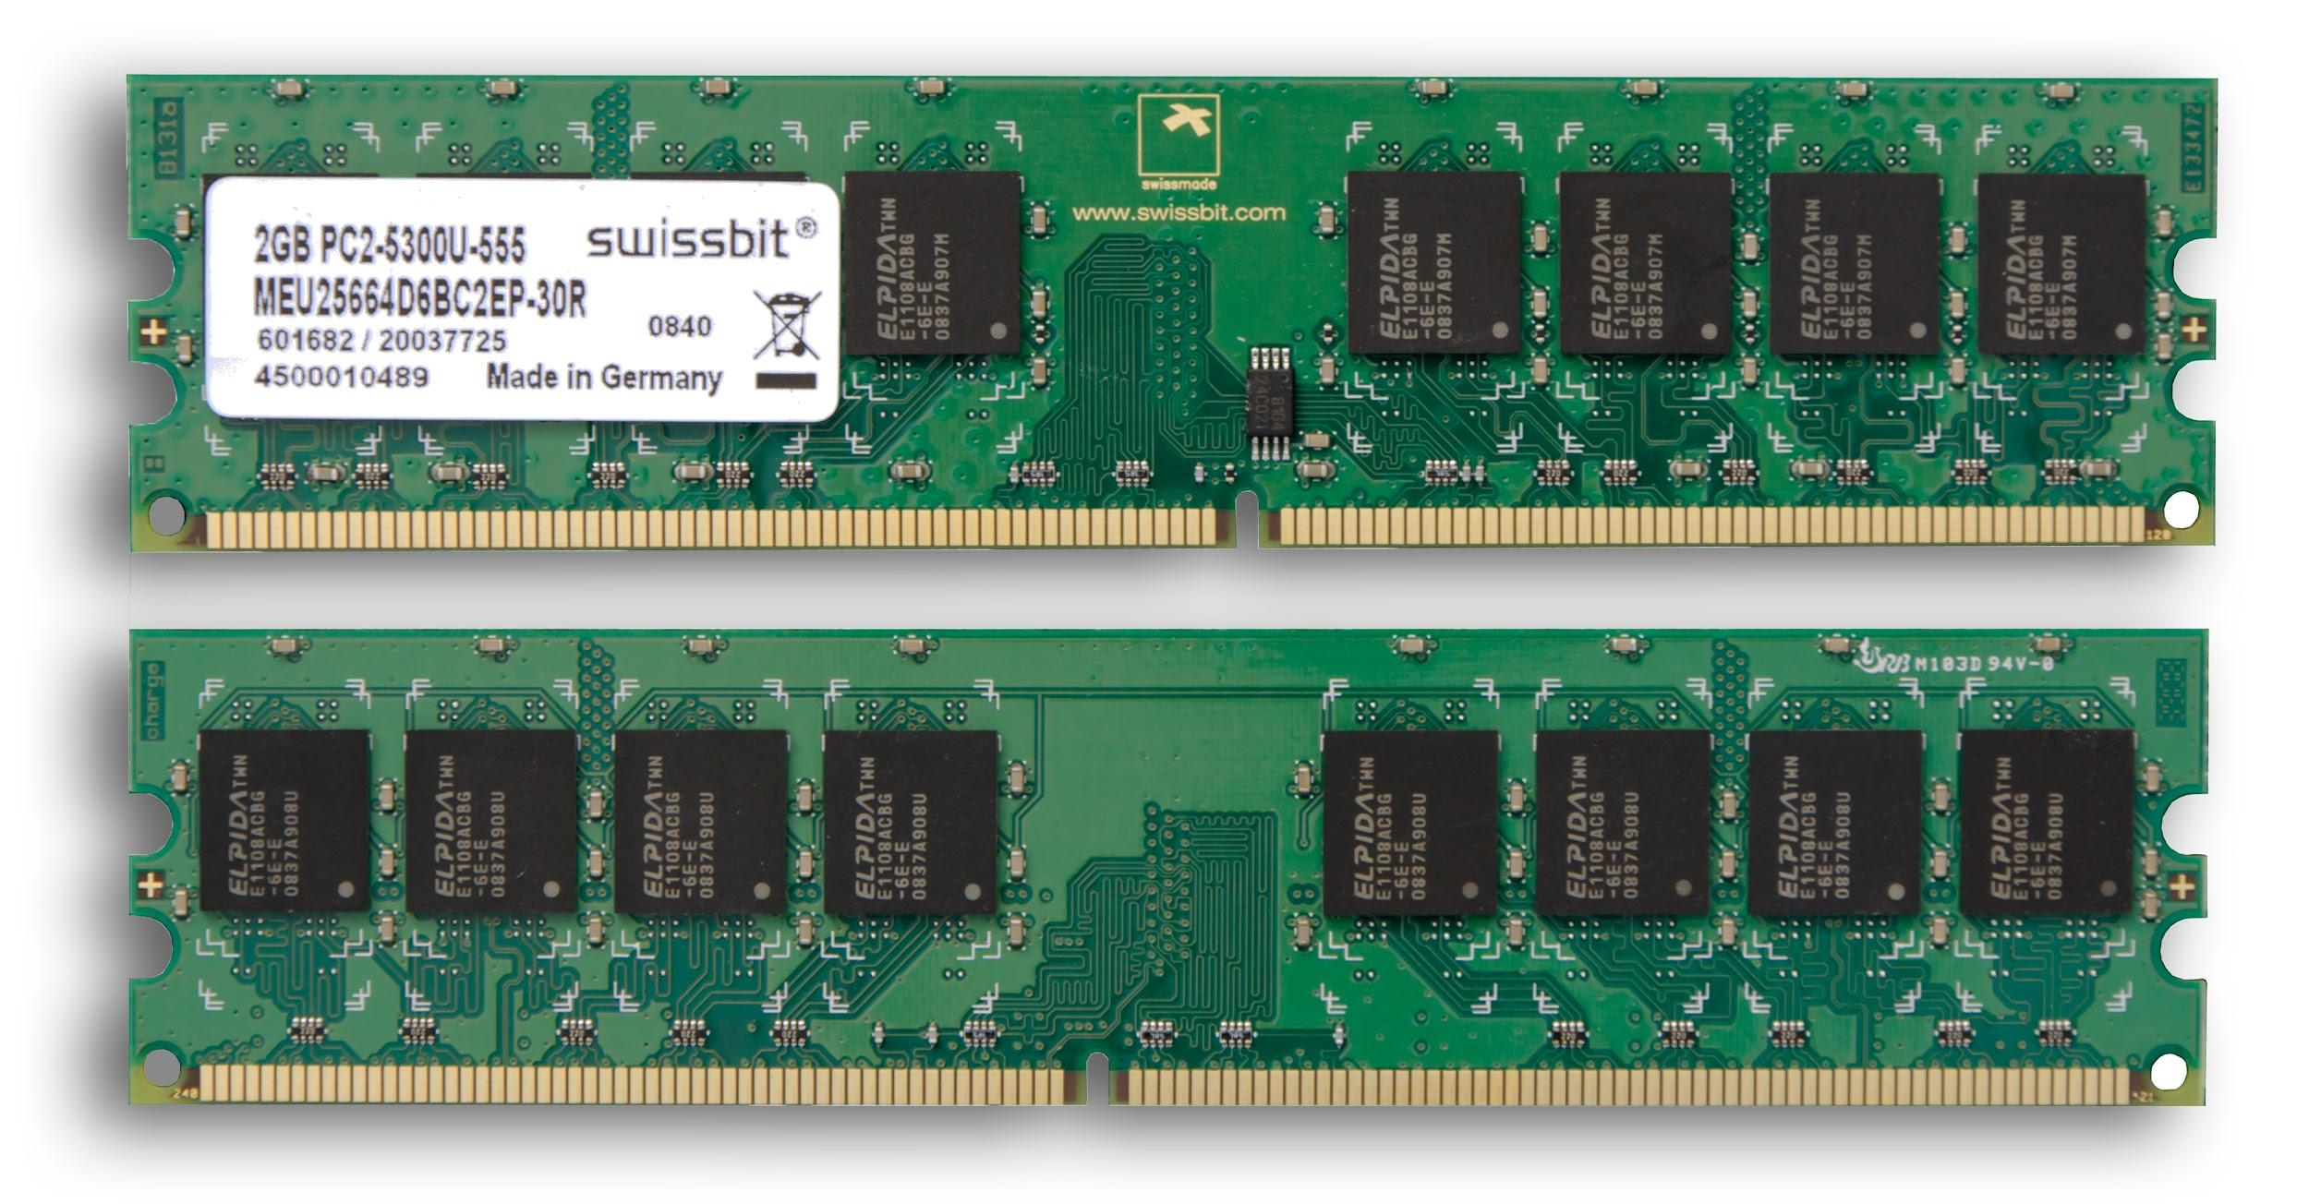
Compute
Memory
Storage
Notes:
https://www.flickr.com/photos/intel_de/9662277285/
https://commons.wikimedia.org/wiki/File:Swissbit_2GB_PC2-5300U-555.jpg
https://commons.wikimedia.org/wiki/File:Samsung_840_EVO_SSD-6_-_top_black.jpg

Slide 9
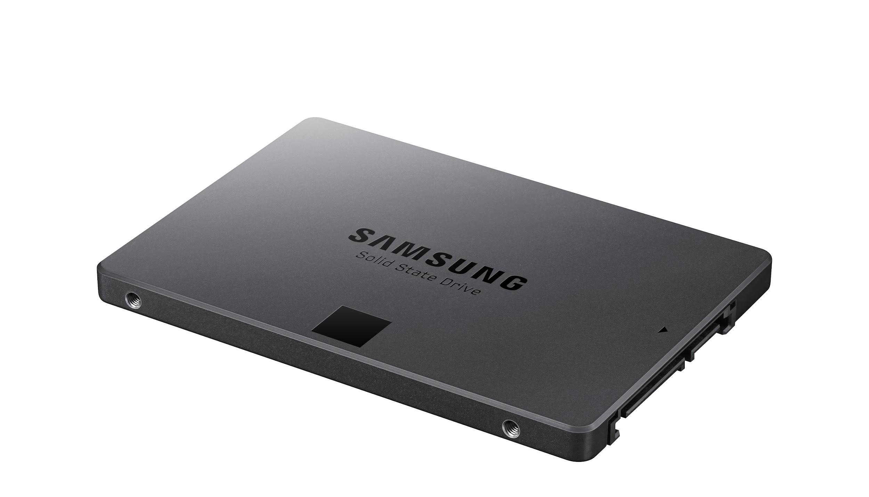
Compute
Memory
Storage
Notes:
https://www.flickr.com/photos/intel_de/9662277285/
https://commons.wikimedia.org/wiki/File:Swissbit_2GB_PC2-5300U-555.jpg
https://commons.wikimedia.org/wiki/File:Samsung_840_EVO_SSD-6_-_top_black.jpg

Slide 10
Microprocessor
v.
Microcontroller
Notes:
https://www.flickr.com/photos/intel_de/9662277285/
https://commons.wikimedia.org/wiki/File:Swissbit_2GB_PC2-5300U-555.jpg
https://commons.wikimedia.org/wiki/File:Samsung_840_EVO_SSD-6_-_top_black.jpg

Slide 11
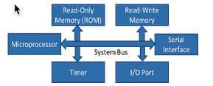
Microprocessor: only one part of the puzzle
Read-Only Memory (ROM)
Read-Write Memory
Microprocessor
Serial
Interface
Timer
I/O Port

Slide 12
Microcontroller
CPU
Read-Only Memory (ROM)
Read-Write Memory
Timer
I/O Port
Serial
Interface

Slide 13
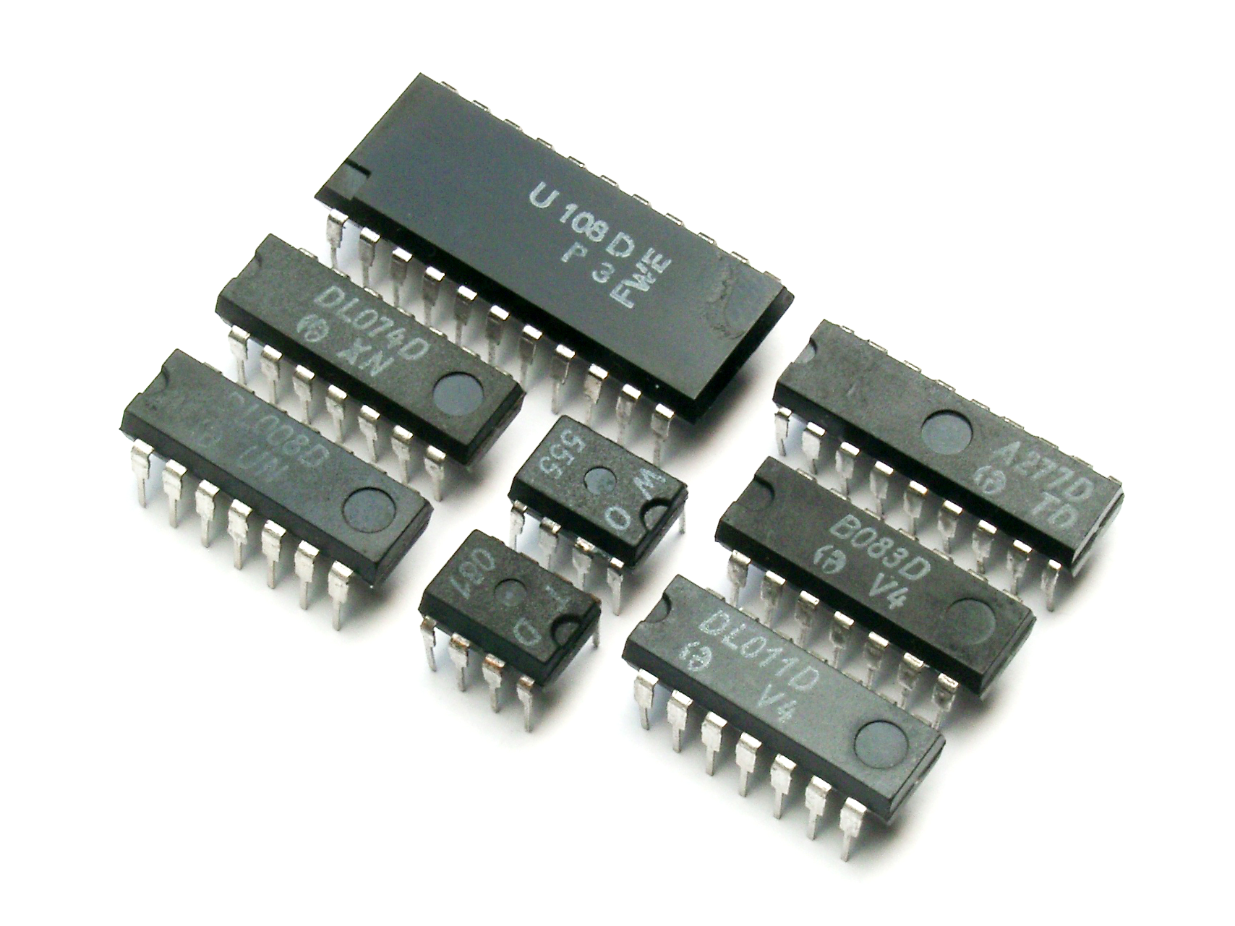
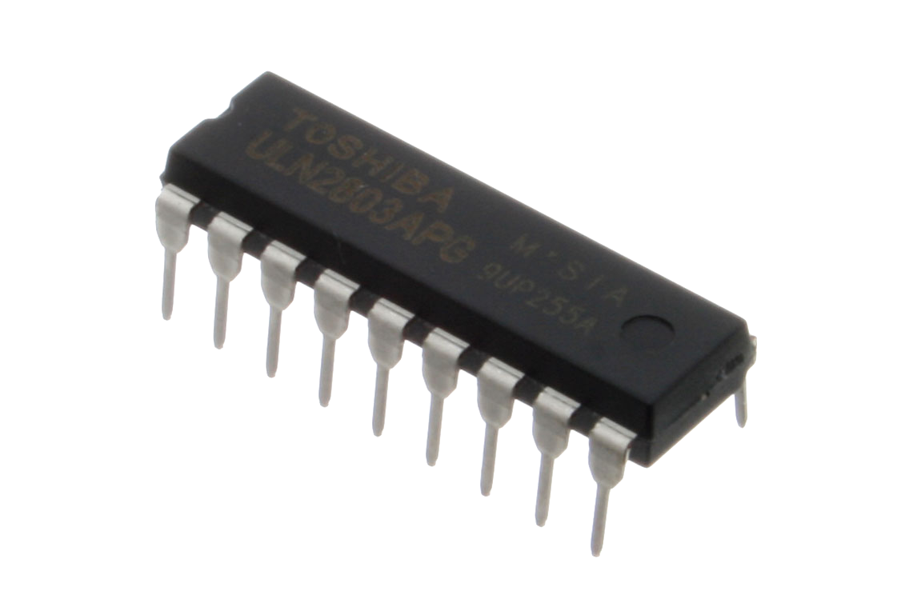
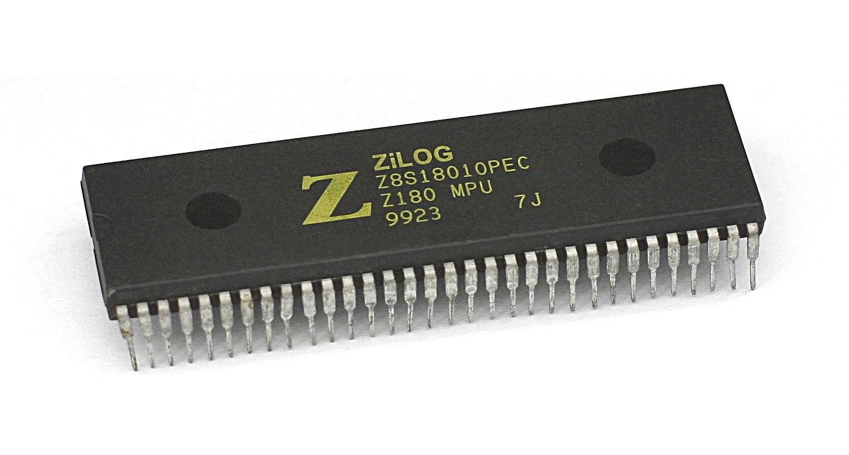
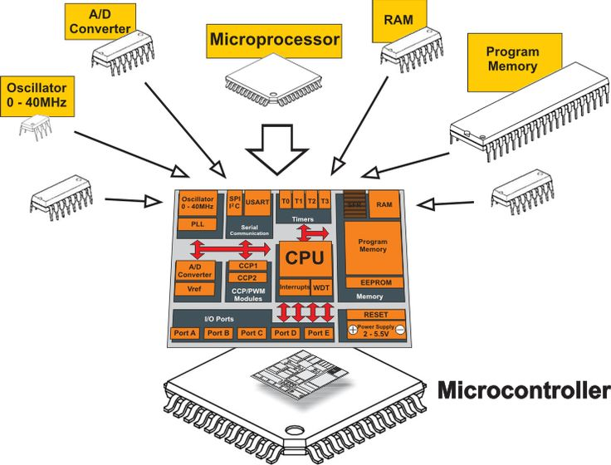
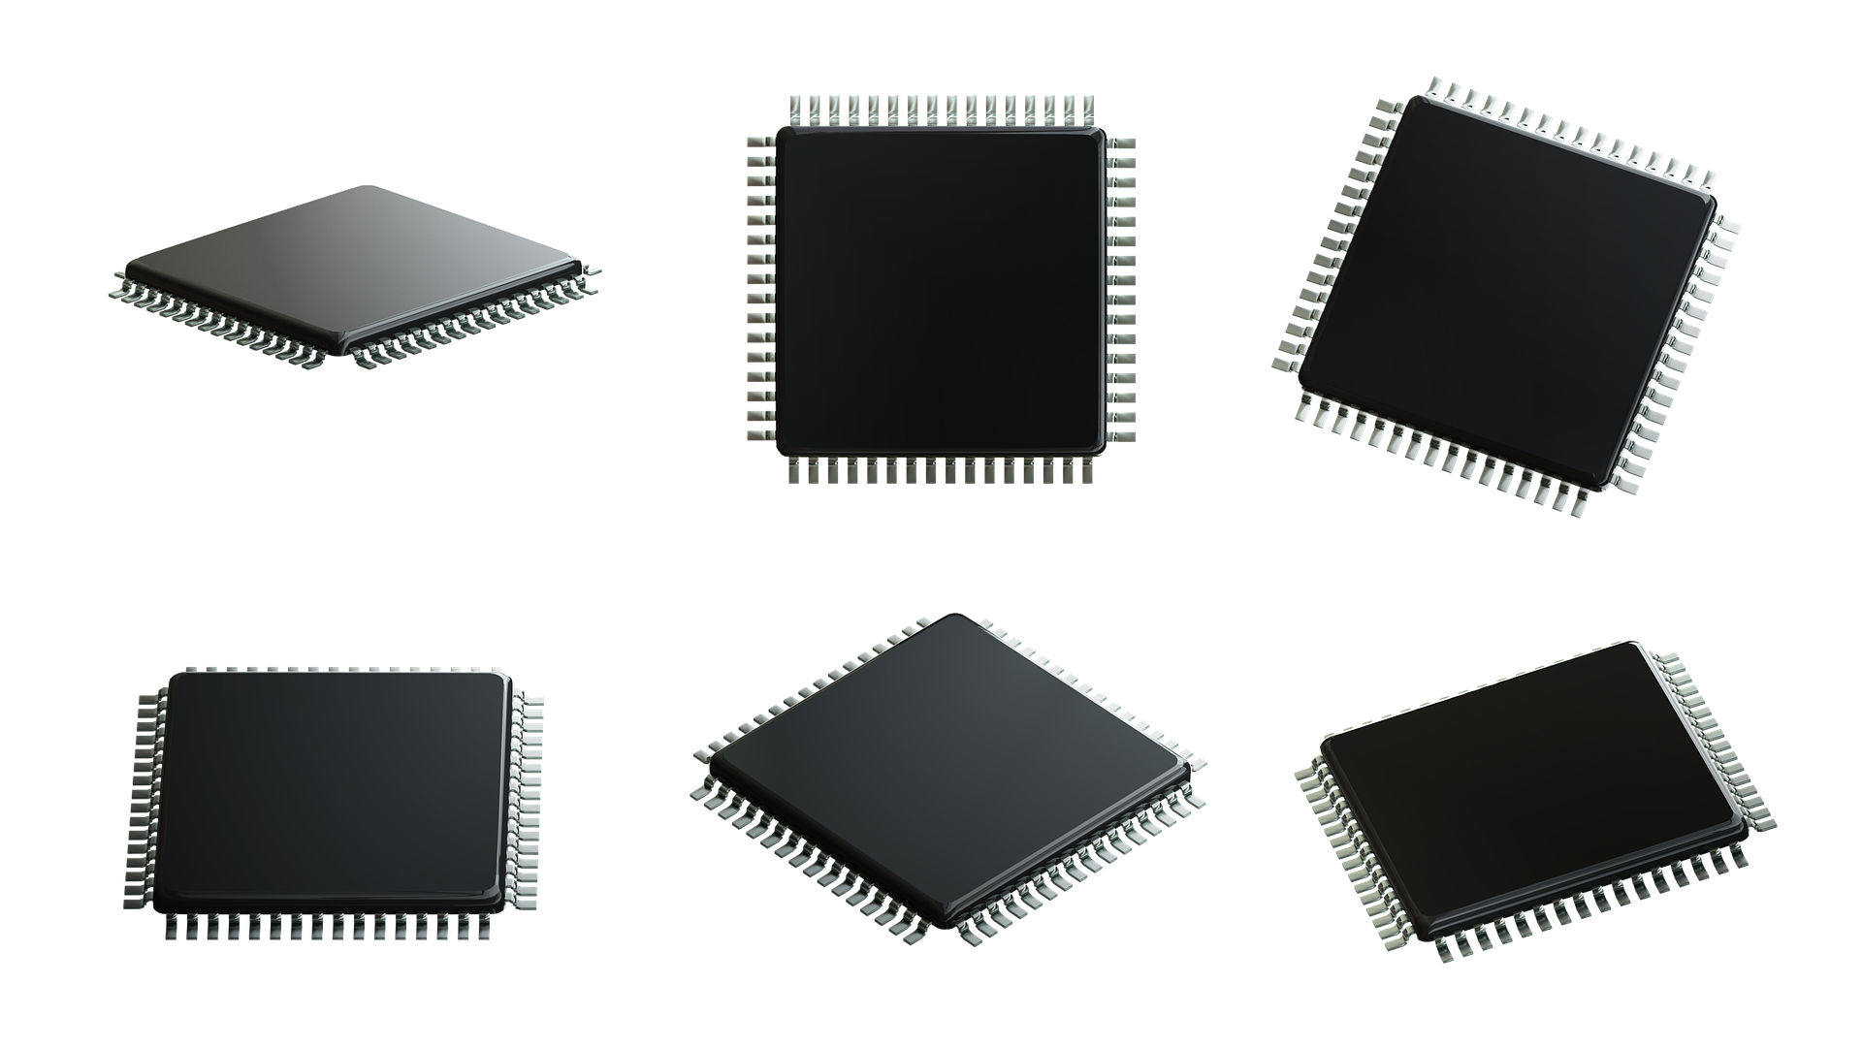
Microcontroller: a complete package
RAM
Memory
CPU
A/D Converter
Timer
Notes:
https://commons.wikimedia.org/wiki/File:ULN2803A_Octal_Transistor_Array_-_IC-ULN2803A_(4149945277).jpg
https://commons.wikimedia.org/wiki/File:MME_IC.jpg
https://pixabay.com/ru/illustrations/%D0%BC%D0%B8%D0%BA%D1%80%D0%BE%D0%BF%D1%80%D0%BE%D1%86%D0%B5%D1%81%D1%81%D0%BE%D1%80-%D0%BF%D1%80%D0%BE%D1%86%D0%B5%D1%81%D1%81%D0%BE%D1%80-%D1%87%D0%B8%D0%BF-3036187/
https://commons.wikimedia.org/wiki/File:KL_Zilog_Z180_DIP.jpg

Slide 14
Microprocessor
Microcontroller
Heart of a computer system
Just the processor, memory and storage are external
Heart of an embedded system
Memory and storage are all internal to the system

Slide 15
Microprocessor
Microcontroller
Heart of a computer system
Heart of an embedded system

Slide 16
Microprocessor
Microcontroller
Heart of a computer system
Just the processor, memory and storage are external
Mainly used in general purpose systems like laptops, desktops and servers
Heart of an embedded system
Memory and storage are all internal to the system
Mainly used in specialized, fixed function systems like phones, MP3 players, etc.

Slide 17
Microprocessor
Microcontroller
Heart of a computer system
Just the processor, memory and storage are external
Mainly used in general purpose systems like laptops, desktops and servers
Offers flexibility in design
Heart of an embedded system
Memory and storage are all internal to the system
Mainly used in specialized, fixed function systems like phones, MP3 players, etc.
Limited flexibility in design

Slide 18
Microprocessor
Microcontroller
Heart of a computer system
Just the processor, memory and storage are external
Mainly used in general purpose systems like laptops, desktops and servers
Offers flexibility in design
System size is big
Heart of an embedded system
Memory and storage are all internal to the system
Mainly used in specialized, fixed function systems like phones, MP3 players, etc.
Limited flexibility in design
System size is tiny

Slide 19
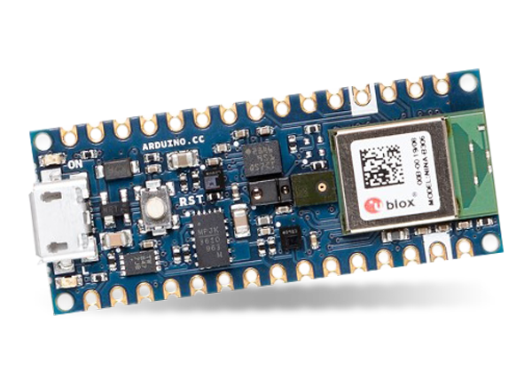
Key Differences
Microprocessor
Microcontroller
Platform
Compute
1GHz–4GHz
1MHz–400MHz
Memory
512MB–64GB
2KB–512KB
Storage
64GB–4TB
32KB–2MB
Power
30W–100W
150μW–23.5mW
 | Microprocessor | Microcontroller
Platform | Laptop | Arduino
Compute | 1 GHz to 4 GHz | 1 MHz to 400 MHz
Memory | 512 MB to 64 GB | 2 KB to 512 KB
Storage | 64 GB to 4 TB | 32 KB to 2 MB

Slide 20
Key Differences
Microprocessor
Microcontroller
Platform
Compute
1GHz–4GHz
1MHz–400MHz
Memory
512MB–64GB
2KB–512KB
Storage
64GB–4TB
32KB–2MB
Power
30W–100W
150μW–23.5mW
 | Microprocessor | Microcontroller
Platform | Laptop | Arduino
Compute | 1 GHz to 4 GHz | 1 MHz to 400 MHz
Memory | 512 MB to 64 GB | 2 KB to 512 KB
Storage | 64 GB to 4 TB | 32 KB to 2 MB

Slide 21
Key Differences
Microprocessor
Microcontroller
Platform
Compute
1GHz–4GHz
1MHz–400MHz
Memory
512MB–64GB
2KB–512KB
Storage
64GB–4TB
32KB–2MB
Power
30W–100W
150μW–23.5mW
 | Microprocessor | Microcontroller
Platform | Laptop | Arduino
Compute | 1 GHz to 4 GHz | 1 MHz to 400 MHz
Memory | 512 MB to 64 GB | 2 KB to 512 KB
Storage | 64 GB to 4 TB | 32 KB to 2 MB

Slide 22
Key Differences
Microprocessor
Microcontroller
Platform
Compute
1GHz–4GHz
1MHz–400MHz
Memory
512MB–64GB
2KB–512KB
Storage
64GB–4TB
32KB–2MB
Power
30W–100W
150μW–23.5mW
 | Microprocessor | Microcontroller
Platform | Laptop | Arduino
Compute | 1 GHz to 4 GHz | 1 MHz to 400 MHz
Memory | 512 MB to 64 GB | 2 KB to 512 KB
Storage | 64 GB to 4 TB | 32 KB to 2 MB

Slide 23
Key Differences
Microprocessor
Microcontroller
Platform
Compute
1GHz–4GHz
1MHz–400MHz
Memory
512MB–64GB
2KB–512KB
Storage
64GB–4TB
32KB–2MB
Power
30W–100W
150μW–23.5mW
 | Microprocessor | Microcontroller
Platform | Laptop | Arduino
Compute | 1 GHz to 4 GHz | 1 MHz to 400 MHz
Memory | 512 MB to 64 GB | 2 KB to 512 KB
Storage | 64 GB to 4 TB | 32 KB to 2 MB

Slide 24
Orders of Magnitude Difference
Microprocessor
>
Microcontroller
Platform
Compute
1GHz–4GHz
~10X
1MHz–400MHz
Memory
512MB–64GB
~10000X
2KB–512KB
Storage
64GB–4TB
~100000X
32KB–2MB
Power
30W–100W
~1000X
150μW–23.5mW
 | Microprocessor | Microcontroller
Platform | Laptop | Arduino
Compute | 1 GHz to 4 GHz | 1 MHz to 400 MHz
Memory | 512 MB to 64 GB | 2 KB to 512 KB
Storage | 64 GB to 4 TB | 32 KB to 2 MB

Slide 25
Implications
Microcontroller
1MHz-400MHz
2KB - 512KB
32KB - 2MB
150μW–23.5mW

Slide 26
Implications
Microcontroller
How complicated is the running task?
1MHz-400MHz
2KB - 512KB
32KB - 2MB
150μW–23.5mW

Slide 27
Implications
Microcontroller
How complicated is the running task?
How much memory does it need to have?
1MHz-400MHz
2KB - 512KB
32KB - 2MB
150μW–23.5mW

Slide 28
Implications
Microcontroller
How complicated is the running task?
How much memory does it need to have?
How long does the job have to perform?
1MHz-400MHz
2KB - 512KB
32KB - 2MB
150μW–23.5mW

Slide 29
Fullscreen. Show presenter.

